Slide 1
Perfect Location and Venue to Start a Business
-Swapnil rane

Slide 2
Introduction
Scarborough is a popular destination for new immigrants in Canada to reside. As a result, it is one of the most diverse and multicultural areas in the Greater Toronto Area, being home to various religious groups and places of worship. It includes a number of natural landmarks, including the Toronto Zoo, Rouge Park and the Scarborough Bluffs. As my client need specific information regarding what kind of business, they should start which can make the highest profit and what kind business is trending in a particular area. So, me as Data Scientist will create a list of popular places and venues in the Scarborough city and provide it to my client

Slide 3
Data
For this implementation I will be using the Wikipedia to gather data regarding postal codes of Canada.
I will do a web scraping of the following Wikipedia link ' https://en.wikipedia.org/wiki/List_of_postal_codes_of_Canada:_M' using Beautiful Soup python library.
I will filter only the Scarborough Data from the table of data collected in step 1 for this project.
For understanding the data collected in the Data collection stage, I will explore the data and do some analysis like:

Slide 4
Data Analysis
Importing all the libraries that are necessary for this project.
Extract the table with postal code, borough and neighborhood data from the Wikipedia link ‘https://en.wikipedia.org/wiki/List_of_postal_codes_of_Canada:_M’ using Beautiful Soup library and save it in a csv file.
If a postal code has a borough but a Not assigned neighborhood (as shown below), then the neighborhood will be the same as the borough.
Group neighborhood based on postal code and borough.
The venues details regarding categories and location is collected using the neighborhood data and Foursquare API
Apply One hot encoding and group rows on neighborhood by taking mean

Slide 5
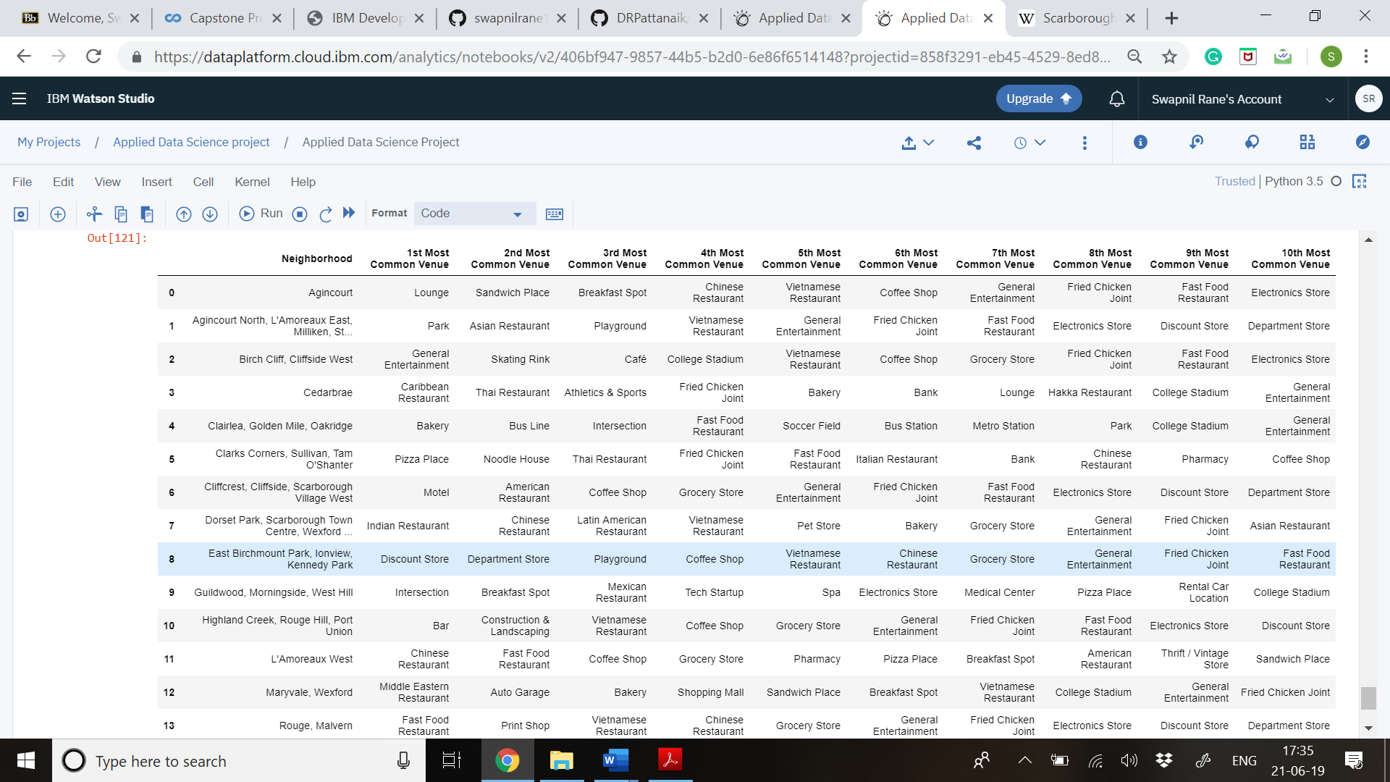
Results

Slide 6
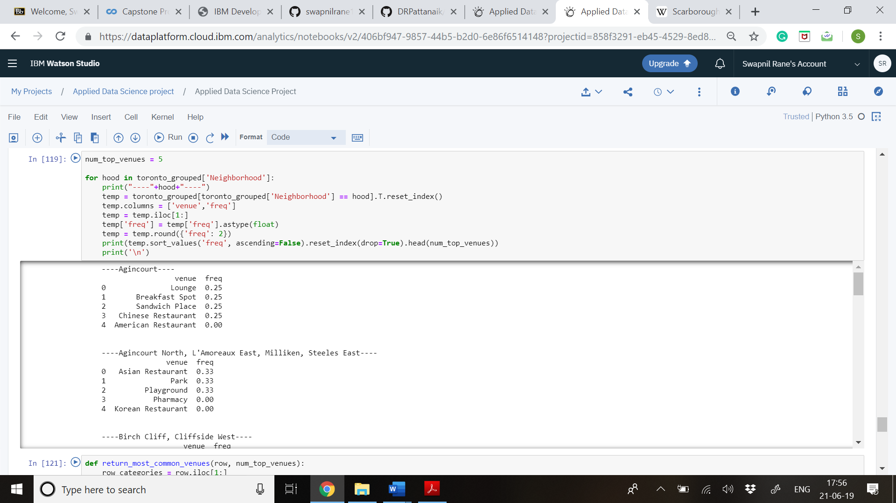

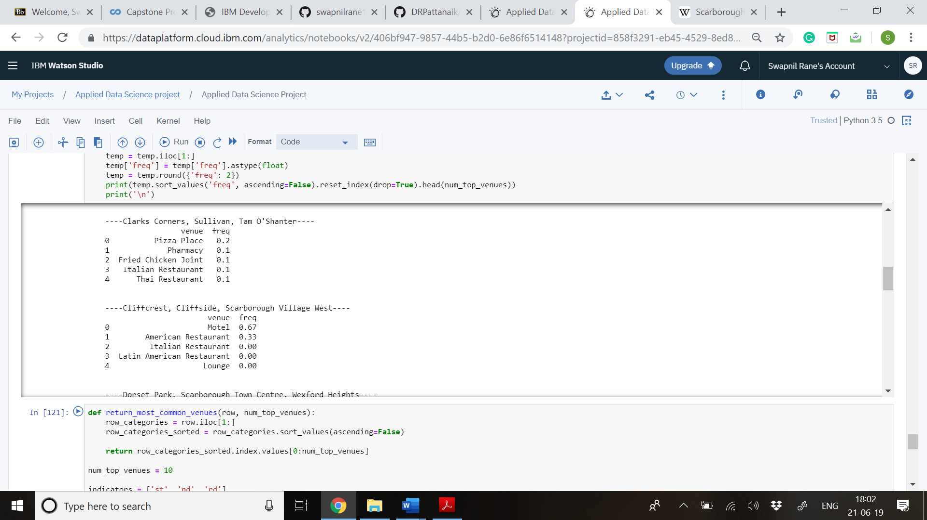
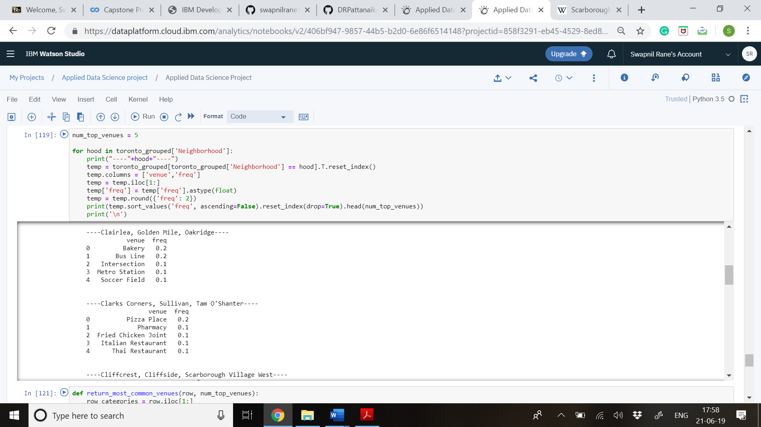
Now that I have the required top 10 data, my client has full access to the information regarding the venues and what kind of business is profitable in that area.
Here are some of the output Data on the frequency of venues in a particular area

Slide 7
Discussions & Observation
While conducting the Data Analysis of this information, I observed that the frequency of the Motel in the Cliffside neighborhood is the highest amongst all the other venues and that this business is in highly demand compared to other businesses.

Slide 8
Conclusion
Hence, I conclude my Data Analysis by providing all the information that is required by my client and advise them to build a Motel in the Cliffside Neighborhood as it has highest frequency and demand. I have also provided them with other business possibilities such venues and location, which can earn them profit in future.

Slide 9
THANK YOU

